Slide 1


Chapter 5
Spanning Tree Protocol
(STP)
Part II

Slide 2
Note for Instructors
These presentations are the result of a collaboration among the instructors at St. Clair College in Windsor, Ontario.
Thanks must go out to Rick Graziani of Cabrillo College. His material and additional information was used as a reference in their creation.
If anyone finds any errors or omissions, please let me know at:
  tdame@stclaircollege.ca.

Slide 3
Spanning Tree Protocol (STP)
PVST+, RTSP and Rapid PVST+
Per-VLAN Spanning Tree (PVST)
Per-VLAN Spanning Tree Plus (PVST+)
Rapid Per-VLAN Spanning Tree Plus (Rapid PVST+)
Rapid Spanning Tree (RSTP)
Multiple Spanning Tree Protocol (MSTP)

Slide 4
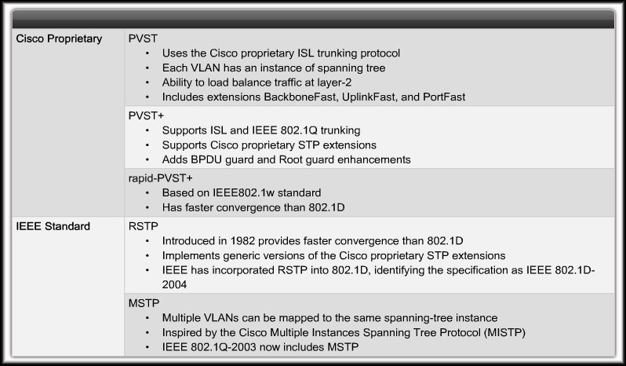
Cisco and IEEE STP Variants

Slide 5
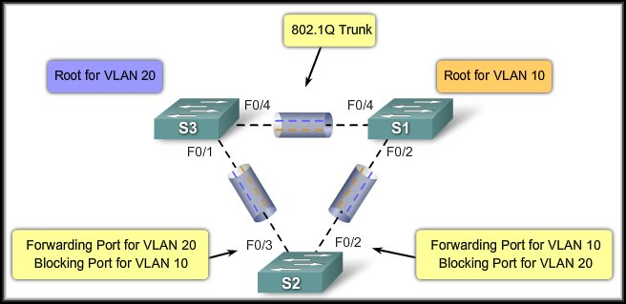
PVST+ (Cisco)
Cisco PVST+:
  A network can run an STP instance for each VLAN in the network.
    Cisco proprietary.
    More than one trunk can block for a VLAN.
    Load sharing can be implemented.
    Means that all switches in the network are engaged in converging the network.
    Switch ports have to accommodate the additional bandwidth used for BPDUs.
    Default for Cisco 2960 switches.

Slide 6
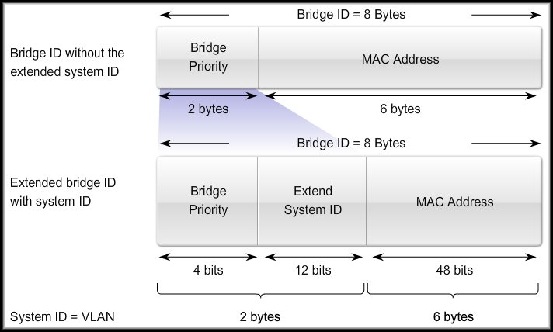
PVST+ (Cisco)
Extended System-ID

Slide 7
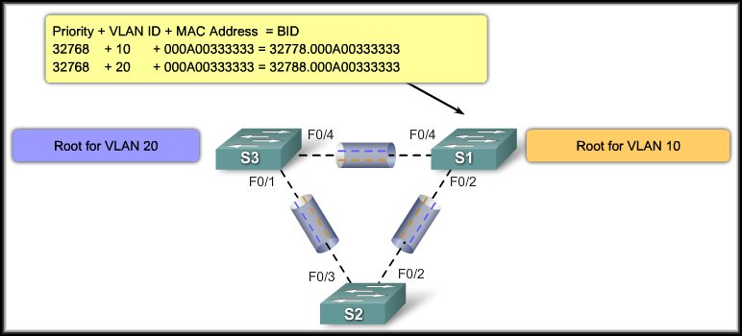
PVST+ (Cisco)
Extended System-ID

Slide 8
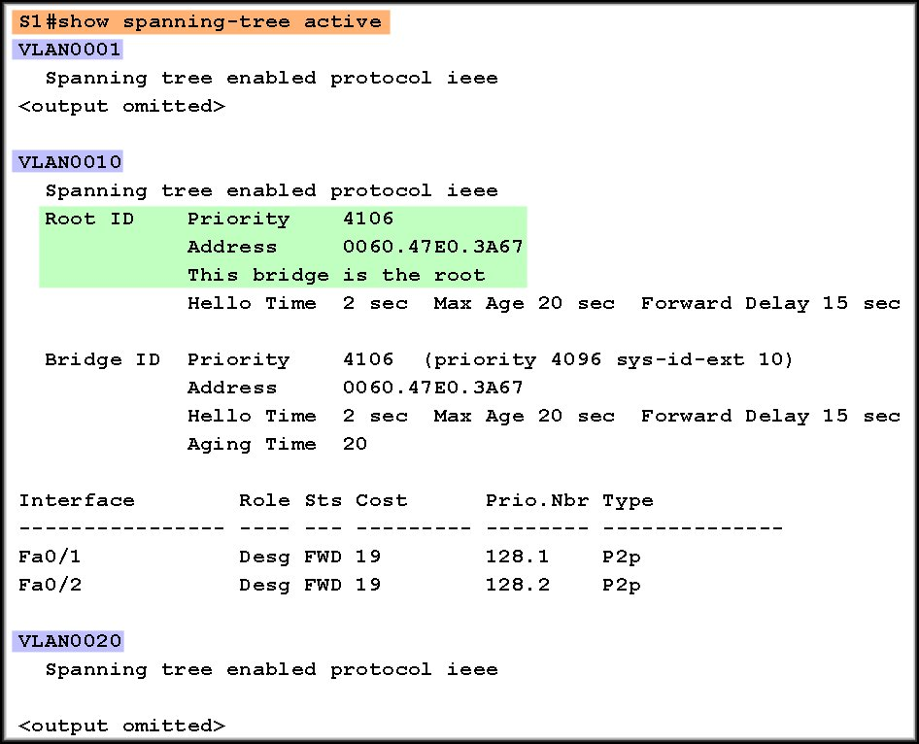
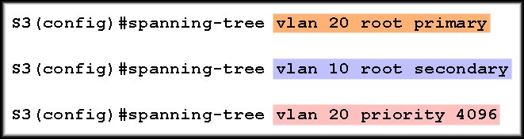
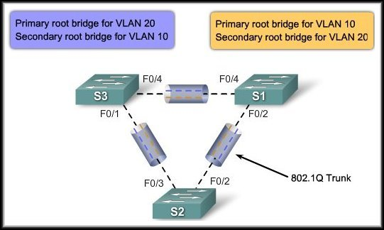
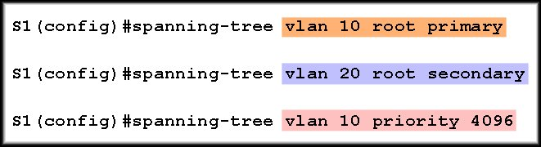
Configure PVST+

Slide 9
Rapid Spanning-Tree Protocol (RSTP)
IEEE 802.1w RSTP:
  What is it?
    Is an evolution of the 802.1D standard.
    Terminology remains primarily the same.
    Most parameters have been left unchanged.
    Speeds the recalculation of the spanning tree on a topology change.
    Much faster convergence.
    Redefines the type of ports and their state.
    Alternate or backup ports can immediately change to a forwarding state without waiting for the network to converge.

Slide 10
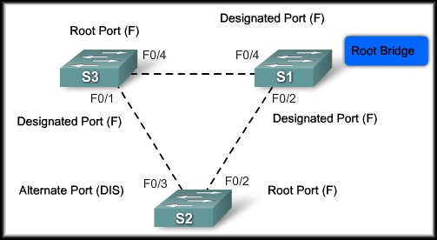
Rapid Spanning-Tree Protocol (RSTP)
IEEE 802.1w RSTP:
  Characteristics:
    Preferred protocol
    for preventing
    Layer 2 loops.
    Cisco-proprietary
    enhancements, such as UplinkFast and BackboneFast, are not compatible with RSTP.
    Retains backward compatibility to 802.1D.
    Keeps the same BPDU format as IEEE 802.1D with the version field is set to 2 to indicate RSTP.
    Port can safely transition to the forwarding state without having to rely on any timer configuration.

Slide 11
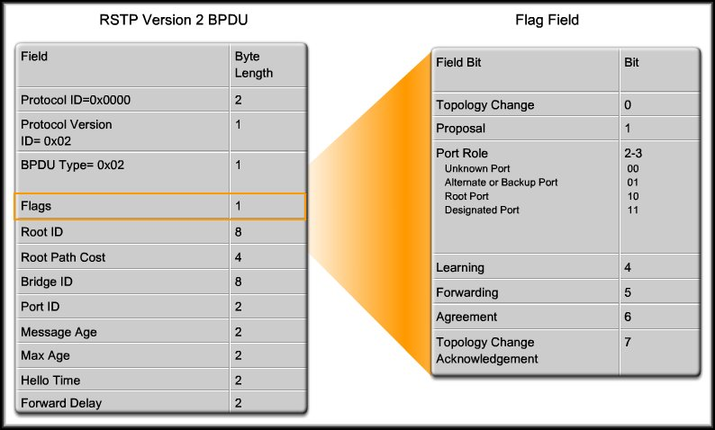
Rapid Spanning-Tree Protocol (RSTP)
802.1D (STP)
Switch only sends an information BPDU when it receives one on the root port.
802.1w (RSTP)
Switch sends an information BPDU every hello time (2 seconds) even if no BPDU has been received on the root port.

Slide 12
Rapid Spanning-Tree Protocol (RSTP)
Rapid Transition to Forwarding State:
  Rapid transition is the most important feature introduced by 802.1w.
    The legacy STA passively waited for the network to converge before it turned a port into the forwarding state.
    The new rapid STP is able to actively confirm that a port can safely transition to the forwarding state without having to rely on any timer configuration.
    In order to achieve fast convergence on a port, the protocol relies upon two new variables:
      Edge Ports
      Link Type.

Slide 13
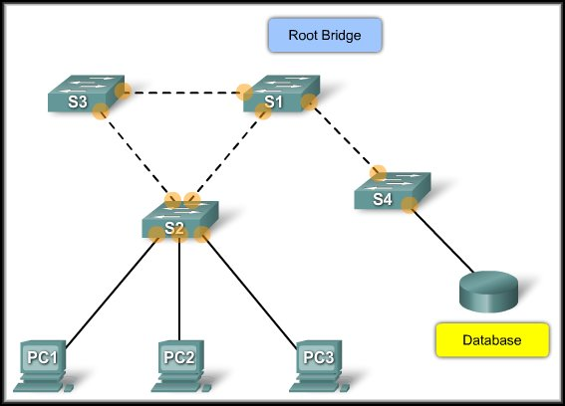
Rapid Spanning-Tree Protocol (RSTP)
Edge Ports:
  An edge port is a switch port that is never intended to be connected to another switch device.
  It immediately transitions to the forwarding state when enabled.
  Does this sound like anything we’ve already discussed?
Non-Edge Ports
Cisco - Portfast
Edge Ports
Non-Edge Ports:
  A non-edge port is a switch port that is always intended to be connected to another switch device.

Slide 14
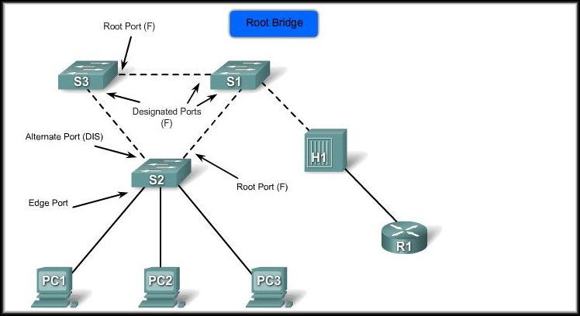
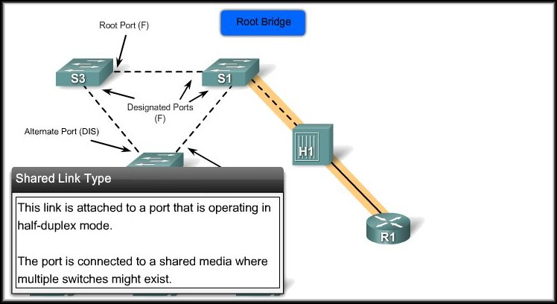
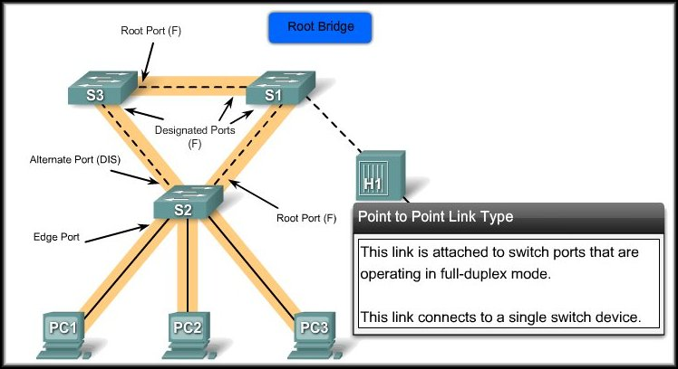
Rapid Spanning-Tree Protocol (RSTP)
Link Types:
  The link type provides a categorization for each port participating in RSTP.
  Non-edge ports are categorized into two link types:
    Point-to-point:
      Connects to a single network device.
    Shared:
      Connects to a shared media where more switches may exist.
  The link type is automatically derived from the duplex mode of a port but this can be overridden.

Slide 15
Rapid Spanning-Tree Protocol (RSTP)
Link Types:
  However, before the link type parameter is considered, RSTP must determine the port role.
    Root Ports:
      Do not use the link type parameter.
    Alternate and Backup Ports:
      Do not use the link type parameter in most cases.
    Designated Ports:
      Make the most use of the link type parameter only if it is a point-to-point link.

Slide 16
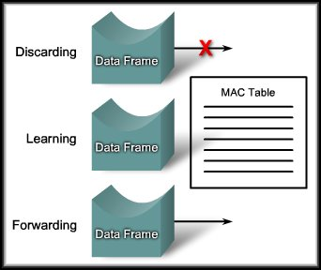
Rapid Spanning-Tree Protocol (RSTP)
Port States:
  An RSTP topology change causes a transition to the forwarding state through either explicit handshakes or a proposal and agreement process and synchronization.
    With RSTP, the role of a port is separated from the state of a port.
      For example, a designated port could be in the discarding state temporarily, even though its final state is to be forwarding.

Slide 17
Rapid Spanning-Tree Protocol (RSTP)
Port States:
  Discarding:
    Prevents the forwarding of data frames.
  Learning:
    Accepts data frames to populate the MAC table.
  Forwarding:
    Forwards data frames and determines the topology.

Slide 18
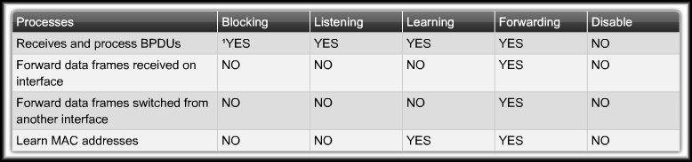
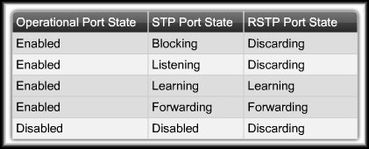
Rapid Spanning-Tree Protocol (RSTP)
STP
RSTP

Slide 19
Rapid Spanning-Tree Protocol (RSTP)
Port Roles:
  The port role defines the ultimate purpose of a switch port and how it handles data frames. Port roles and port states are able to transition independently of each other.
    Root Port
    Designated Port
    Alternate Port
    Backup Port
  Creating the additional port roles allows RSTP to define a standby switch port before a failure or topology change.

Slide 20
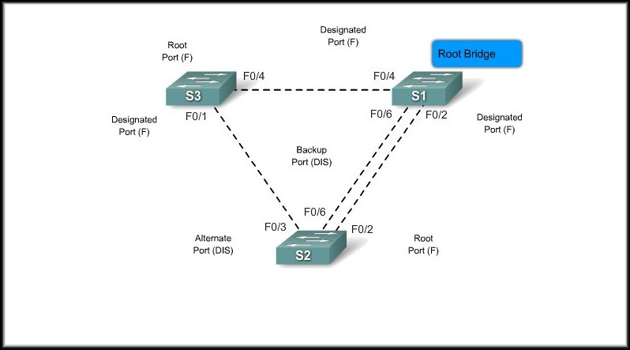
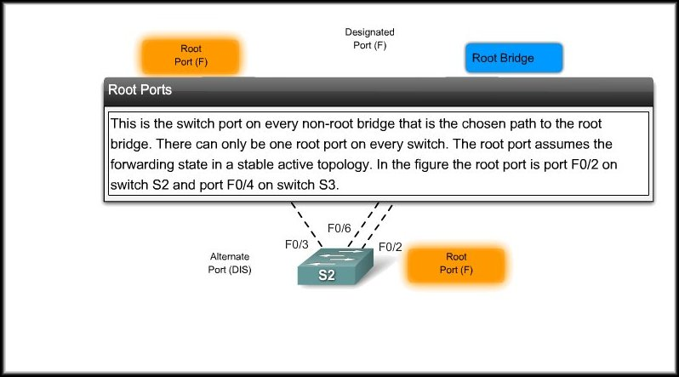
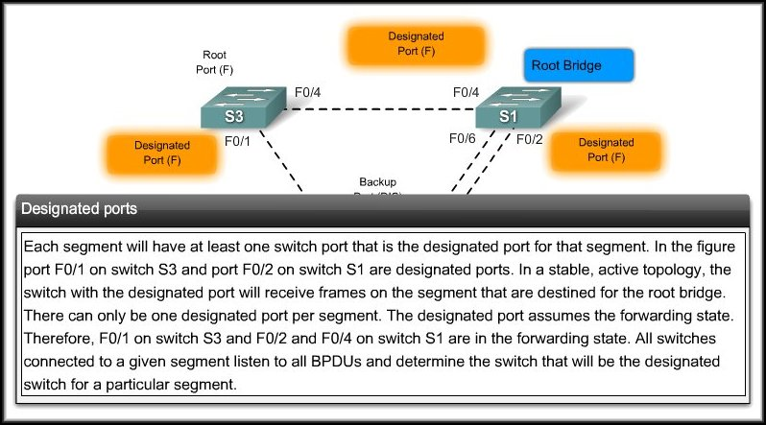
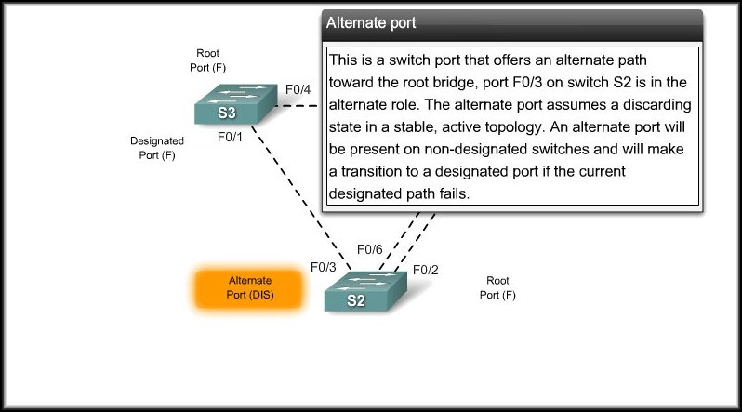
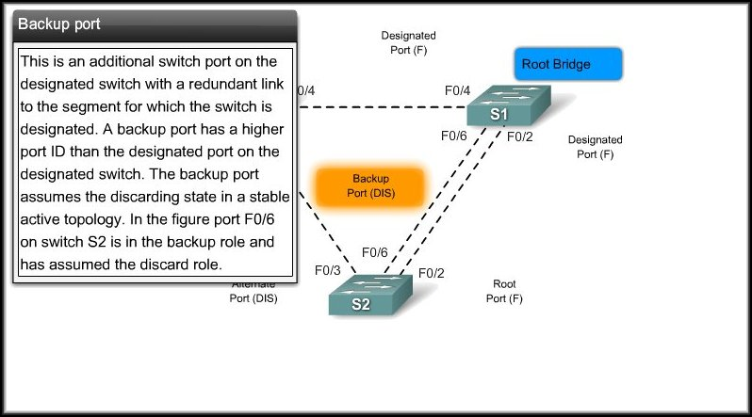
Rapid Spanning-Tree Protocol (RSTP)
Port Roles:

Slide 21
RSTP Proposal and Agreement Process
In IEEE 802.1D STP:
  A designated port must wait two times the forward delay before transitioning the port to the forwarding state.
RSTP:
  Significantly speeds up the recalculation process after a topology change.
  It converges on a link-by-link basis and does not rely on timers expiring before ports can transition.
  Only on edge ports and point-to-point links.

Slide 22
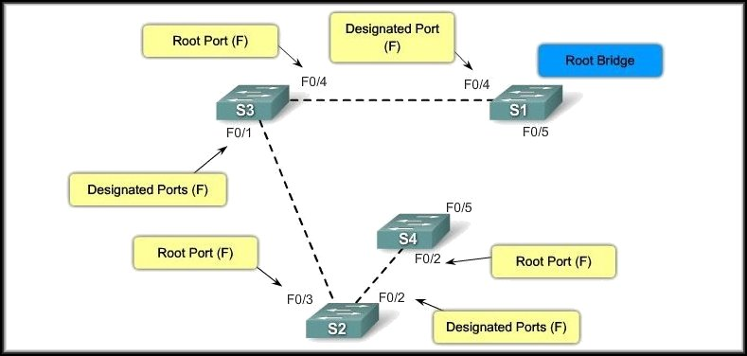
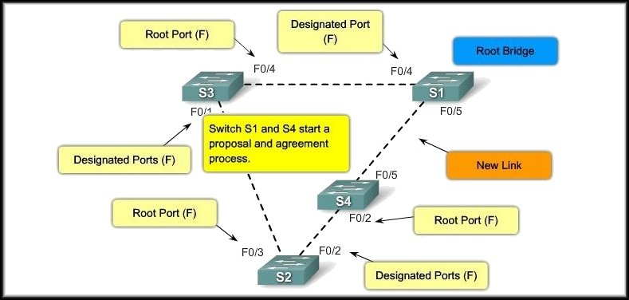
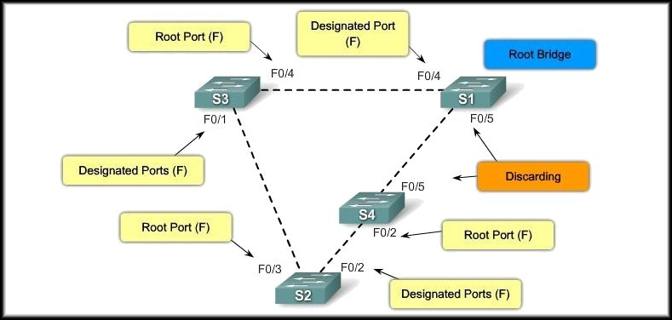
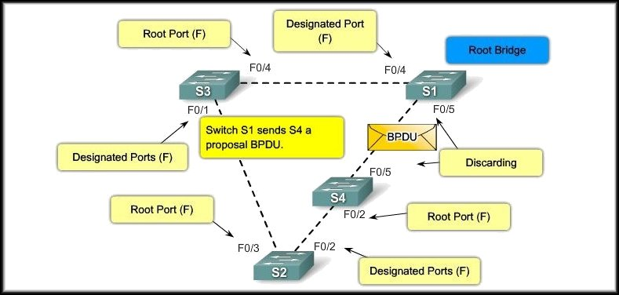
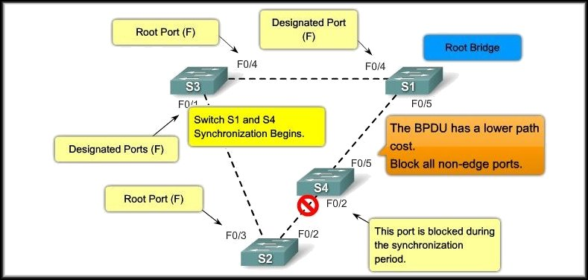
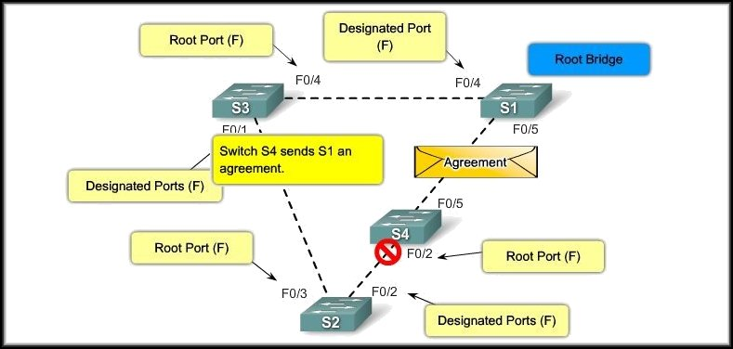
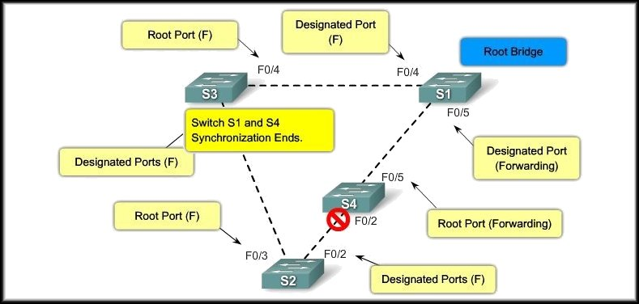
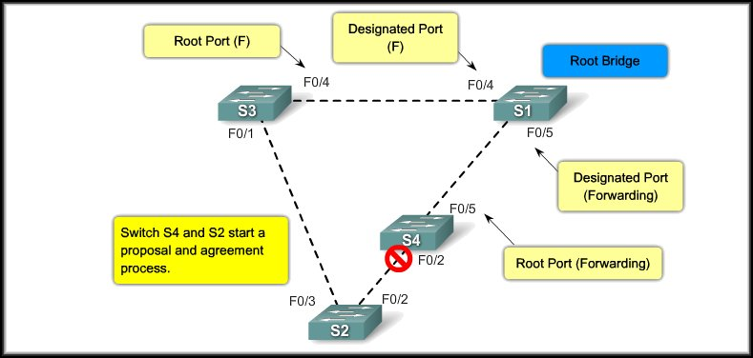
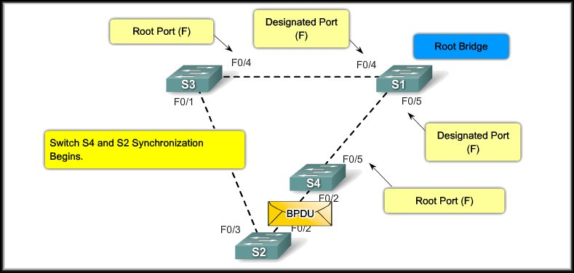
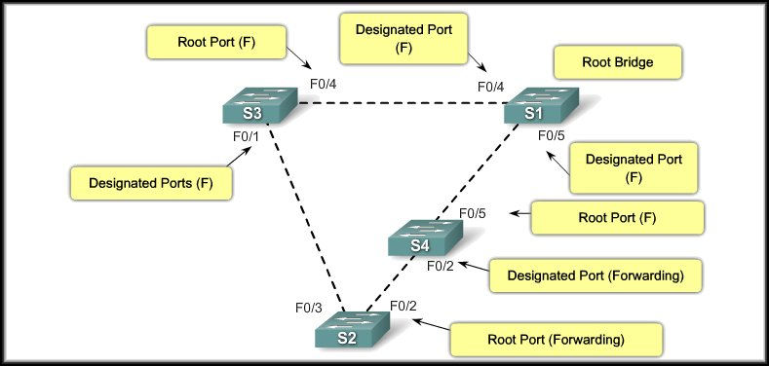
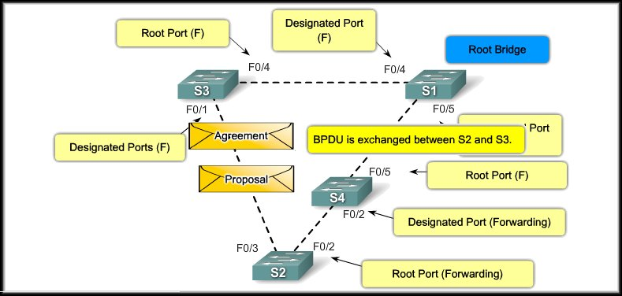
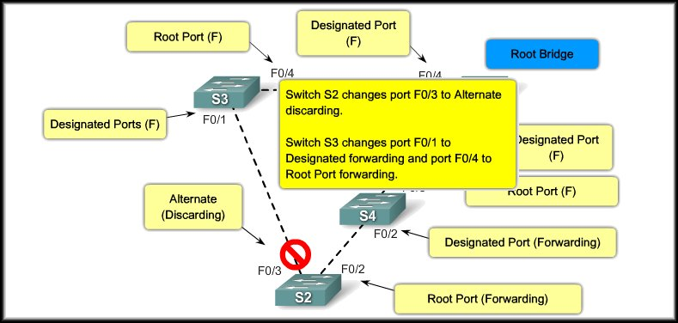
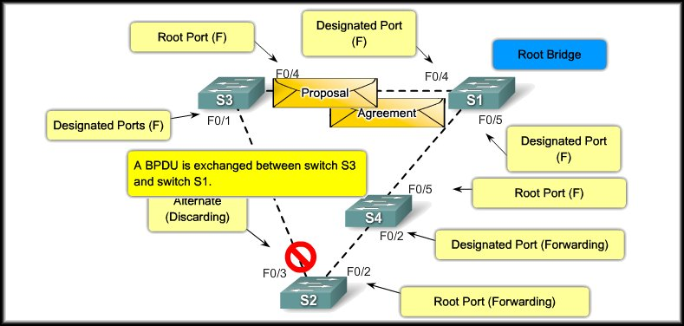
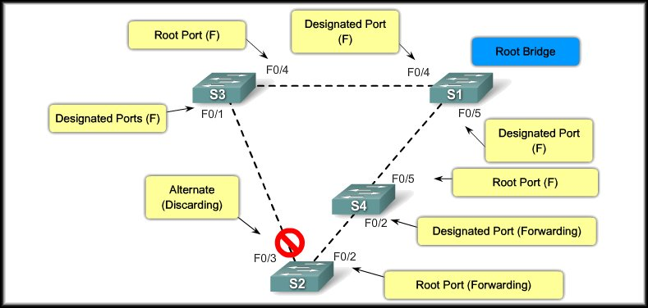
RSTP Proposal and Agreement Process

Slide 23
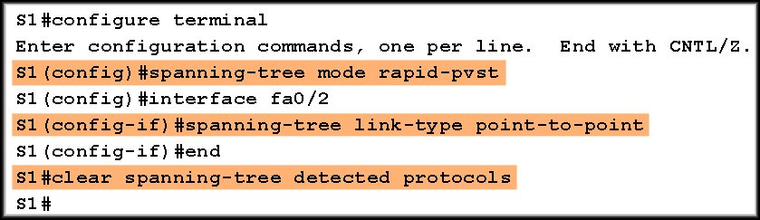
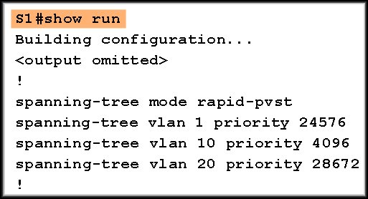
Configuring Rapid-PVST+
Rapid PVST+ is a Cisco implementation of RSTP.
  Supports spanning tree for each VLAN.
  Rapid STP variant to use in Cisco-based networks.

Slide 24
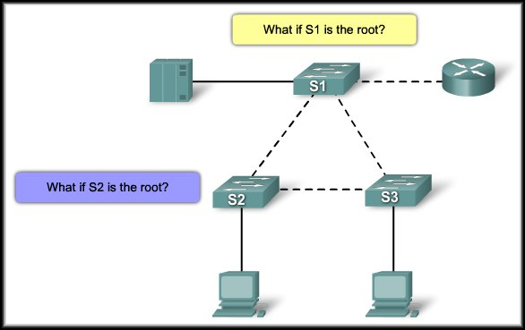
Design STP for Trouble Avoidance
Know where the root is:
Either – not both!

Slide 25
Design STP for Trouble Avoidance
Know where the root is:
Either – not both!

Slide 26
Design STP for Trouble Avoidance
Minimize the Number of Blocked Ports:
  The only critical action that STP takes is the blocking of ports.
  A good way to limit the risk inherent in the use of STP is to reduce the number of blocked ports as much as possible.
  In non-hierarchical networks you might need to tune the STP cost parameter to decide which ports to block.

Slide 27
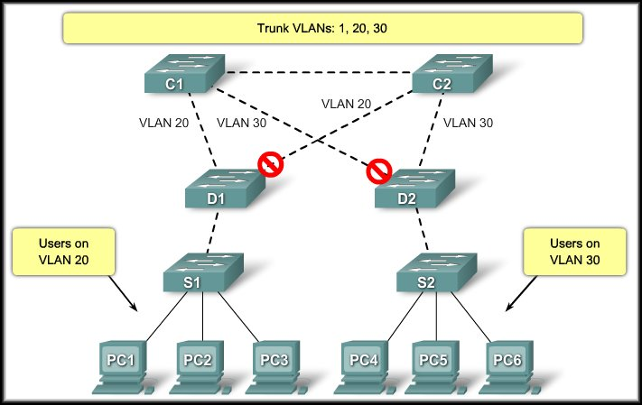
Design STP for Trouble Avoidance
Minimize the Number of Blocked Ports:
  You do not need more than two redundant links between two nodes in a switched network.
Know the location of redundant links and which ports are blocked.

Slide 28
Design STP for Trouble Avoidance
VTP or Manual Pruning:
  Prune any VLAN that you do not need off your trunks.

Slide 29
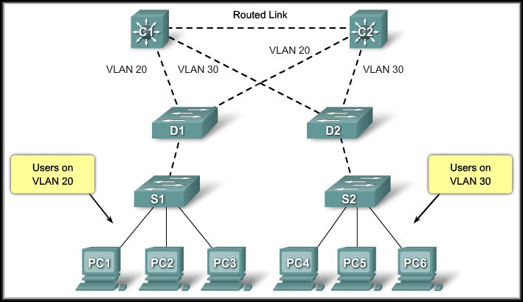
Design STP for Trouble Avoidance
Use Layer 3 Switching:
  Layer 3 switching means routing approximately at the speed of switching.
There is no speed penalty with the
routing hop and an additional
segment between C1 and C2.
Core switch C1 and core switch C2
are Layer 3 switches so there
is no possibility for a loop.
STP no longer blocks any single port.
There is no potential for a bridging loop.

Slide 30
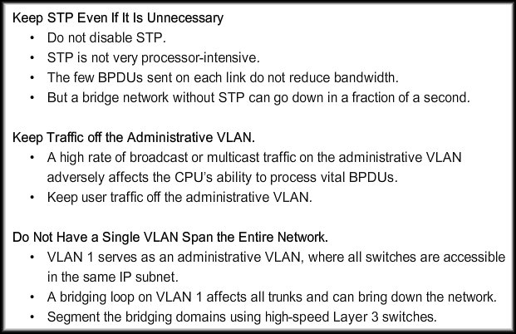
Design STP for Trouble Avoidance
Final Points:

Slide 31
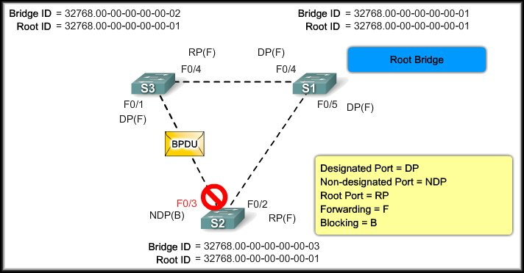
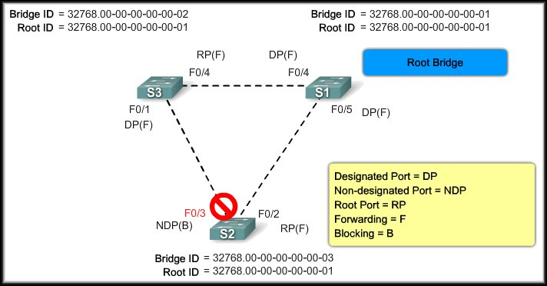
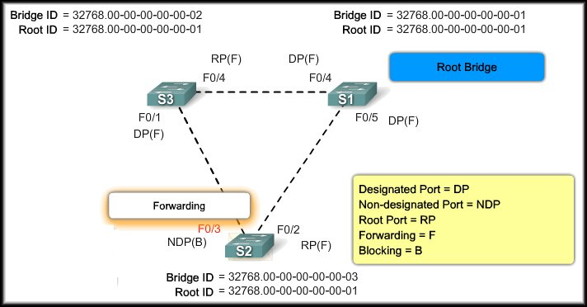
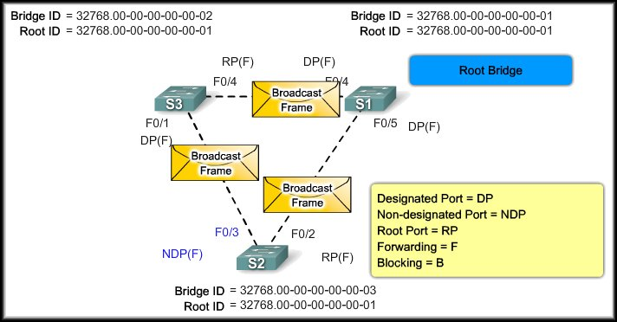




Troubleshoot STP Operation
STP Failure:
Fully converged.
As long as S2 receives BPDUs from S3, it will block broadcasts.
BROADCAST STORM!
For some reason, F0/3 on S2 fails to receive BPDUs within the age time of 20 seconds.
TRANSITIONS TO THE FORWARDING STATE.

Slide 32
Troubleshoot STP Operation
STP Failure:
  Unfortunately, there is
  no procedure to deal
  with this type of failure.
  In-band access may
  not be available during
  a bridging loop…console access may be required.
  Before you can troubleshoot a bridging loop, you need to know how the network is set up when it works properly.
    Topology of the bridge network.
    Location of the root bridge.
    Location of the blocked ports and the redundant links.
BROADCAST STORM!

Slide 33
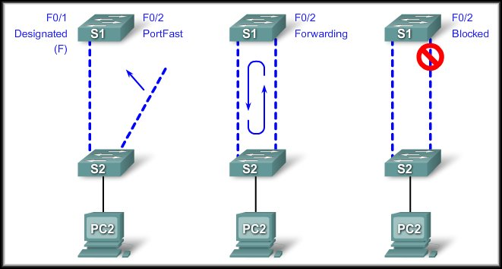
Troubleshoot STP Operation
PortFast Configuration Error:
  Typically PortFast is enabled only for a port or interface that connects to a host.
  Do not use PortFast on switch ports or interfaces that connect to other switches, hubs, or routers.
  You may create a network loop.
Do not use PortFast on switch ports or interfaces that connect to other switches, hubs, or routers. You may create a network loop.

Slide 34
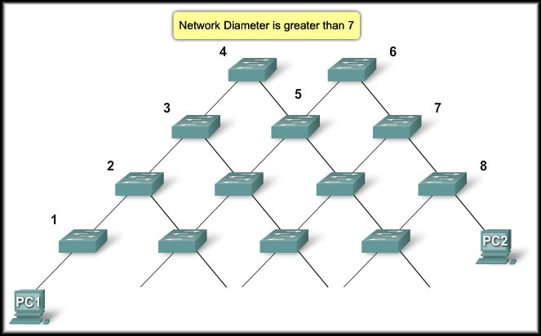
Troubleshoot STP Operation
Network Diameter Issues:
  The default values for the STP timers impose a maximum network diameter of seven.
  In other words, two distinct switches cannot be more than seven hops away.
  Part of this restriction comes from the age field that BPDUs carry.
    When a BPDU propagates from the root bridge toward the leaves of the tree, the age field increments each time the BPDU goes though a switch.
  If the root is too far away from some switches of the network, BPDUs will be dropped.

